Slide 1
複習C語言練習程式 (TOTAL=350)
限用cin, cout
務必繳交Word report
不合以上兩個條件，以0分計算

Slide 2
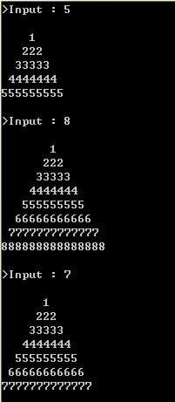
1.cpp (50%)
請輸出左圖：
Write a function:
void draw(int n);

Slide 3

2.cpp (50%)
if…else program
Input (cin) 3 integers a, b, c. Print the maximum, minimum, sum and average (print the two digits after the decimal point) of the three integers.
輸入(cin)三個整數 a、b、c，印出此三數的最大值、最小值、總和及平均值 (取小數2位)。
Please show two different outputs.
Output example:
Enter a=10
Enter b= 2
Enter c= 88
Max=88
Min=2
Sum=100
Average=33.33
Output example:
Enter a=
Enter b=
Enter c=
Max=
Min=
Sum=
Average=

Slide 4
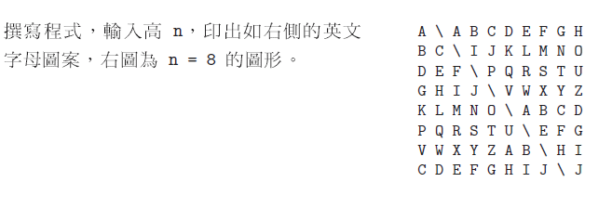
3.cpp (50%)
void draw(int n);

Slide 5
4.cpp (50%)
Input an odd number n, compute the value of 1 + 3 + 5 +… + n
  Check whether n is an odd number, please check until input correctly
  Output as the example
輸入正整數奇數 n,求1 + 3 + 5 +… + n 的值
  檢查是否為奇數(若非奇數，則重新輸入，直至輸入數字為奇數) (請用一個while來檢查)(或do while)
  印出如下結果 (請用while來做加法，並印出過程和結果)
Output example
紅字部分請用變數
Enter an odd number=2
Error!
Enter an odd number=11
Sum:1+3+5+7+9+11=36
為了程式正確性，
請自行驗證其他數值

Slide 6
5.cpp (50%)
Write functions:
bool is_prime(int n);
void print_prime(int start, int end, int count);
e.g. 請列印300~2000之間所有質數，5個為一列
print_prime(300, 2000, 5);

Slide 7
6.cpp struct (p7-p10) (100%)
定義一個(STUDENT)用來放個人成績 (每個struct/class只放一個人的資料)
  name: char[50]
  english: int
  math: int
  Function1: get_student_data
    參數: STUDENT *s (Call by address)
    讀入學生資料
  Function2: output_student_data
    參數: STUDENT s (Call by value)
    輸出學生資料 (平均成績，請印小數兩位數)
  Function3: void menu(void);
    印出menu (見下頁)

Slide 8
Menu-driven Interface
main()
  宣告一陣列，可以最多儲存10位學生資料: STUDENT student[10];
Enter a choice:
0. Enter the students’ names and grades
1. Print the all students’ grades
2. Find the student who has highest grade(總分)
3. End program
? 0
Enter the number of students: 3
Student’s name = Mary
Math = 88
English = 60
Student’s name = John
…
舉例: Call function:
get_student_data( &student[0] );
output_student_data( student[0] );

Slide 9
Menu-driven Interface (2)
Enter a choice:
0. Enter the students’ names and grades
1. Print the all students’ grades
2. Find the student who has highest grade(總分)
3. End program
? 1
Math English
Mary 88 60
John 40 30
Cindy 100 80
Enter a choice:
0. Enter the students’ names and grades
1. Print the all students’ grades
2. Find the student who has highest grade(總分)
3. End program
? 2
Cindy

Slide 10
Menu-driven Interface (3)
Enter a choice:
0. Enter the students’ names and grades
1. Print the all students’ grades
2. Find the student who has highest grade(總分)
3. End program
? 3
Bye bye!

